Slide 1

A gender Distribution of Loan in a Texas Area
Moise MASSON
TABLEAU PROJECT
Due Sunday, June

Slide 2
Objectives
Intro
Describe How Loan are distributed by Gender
Discussion & Proposed Solution

Slide 3
Intro
In an area of Texas, It seems that loan are distributed differently by gender regardless of a monthly distribution or number of transaction

Slide 4
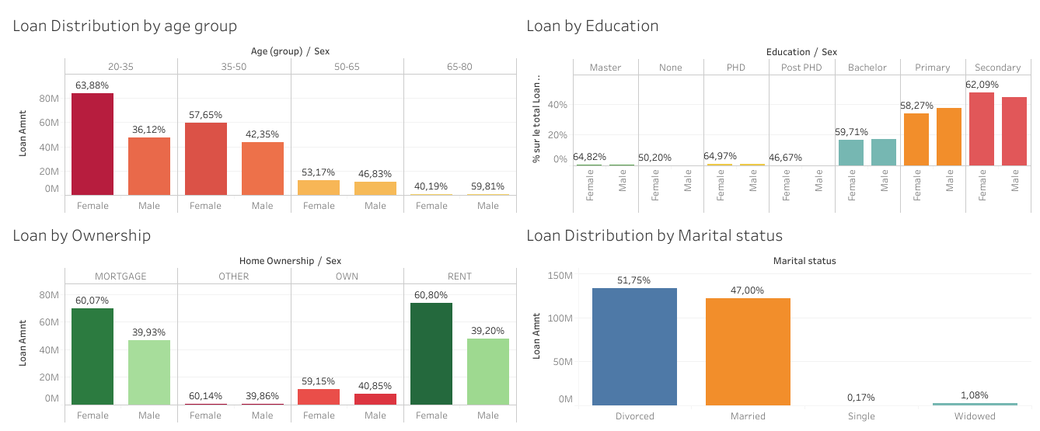
Describe How Loan are distributed by Gender
60% of the loan is given to Woman against 40% for man
20-35 aged woman ,are given 64% of the loan
People who have less than $ 200,000 annual income receive 97% of the loan where 60% are given to woman and 40% to man
Woman receive in average $ 5,000 more than man
Divorced (52%) and married (47%) people have received more money than others (single, widowed)
Woman with a Secondary (62%), Primary (52%), Bachelor degree are largely getting more loan than man
Woman with less than 15 years old of experience are getting more loan than man in order of 60%

Slide 5
Discussion & Proposed Solution
The bank has to notice that not many loan are given to woman with less than a bachelor degree, in order to increase the amount loan for woman the bank have to check and track these category
Most of loan are centered to group of women aged 20 to 35, the bank could also target woman between 35 to 45
Most of loan are less than $ 10,000 for women aged 20 to 35 with less than 15 of work experience and earned less than $ 15,000 by month. By the way, the bank makes less than 1,000 monthly small loan transaction. The bank could also increase the amount of credit for this category of woman

Slide 6
THANK YOU

